Slide 1
Python
Fundamentals
Strings, Integers, Cast, Operators

Slide 2
Python Indentations - the indentation is very important.
Indentation means – space for each Line in the code. White space – matters !!
Indentation to indicate a block of code.

Slide 3
comments
# #This is a comment. – hash
‘’’ ‘’’’ - doc string for multi line
"""This is a
multiline docstring.""“

Slide 4
Creating Variables
Python has no command for declaring a variable.
No need to use Prefix / suffix like “$” or “Int”
Eg: x = 10
Auto Data type. No need declare specifically.
x = 4 # x is of type int
x = "Sally" # x is now of type string

Slide 5
Variable Names
A variable name must start with a letter or the underscore character
A variable name cannot start with a number
A variable name can only contain alpha-numeric characters and underscores (A-z, 0-9, and _ )
Variable names are case-sensitive (age, Age and AGE are three different variables)

Slide 6
Print()
Print(“ text” + txt )
combine a st
ring and a number, - Error
x = 100
y = "Pavan"
#print(x+y) - error print(x, y)

Slide 7
Python Numbers
Int = 1
Float = 1.25
Complex = 1+4j
print(type(x))

Slide 8
cast
specify a type on to a variable.
Convert
Int(x) float(x)
Complex(x)
y = int(2.8) # y will be 2

Slide 9
String
Text
Character
either single quotation marks, or double quotation marks.
‘pavan’, “ pavan “

Slide 10
a = "hello" print(a[1]) # position in the text
print(a[2:4]) # range, substring
strip() - removes any whitespace from the beginning or the end:
print(a.strip())
print(len(a))

Slide 11
lower()
upper()
replace("H", "J")
split(",") # most used !! , converts to array

Slide 12
Command-line String Input
Input()
print("Enter your name:")
x = input()
print("Hello, " + x)

Slide 13
Operators
Arithmetic operators ( + , - , %, / , % (modulus),** ,// ( Floor dividion )
Assignment operators
Comparison operators
Logical operators
Identity operators
Membership operators
Bitwise operators

Slide 14
% Modulus
** Exponentiation
// Floor division

Slide 15
x = 100
y = 26
print(x%y) # Remainder
print(x**y)
print(x//y) # quotient

Slide 16
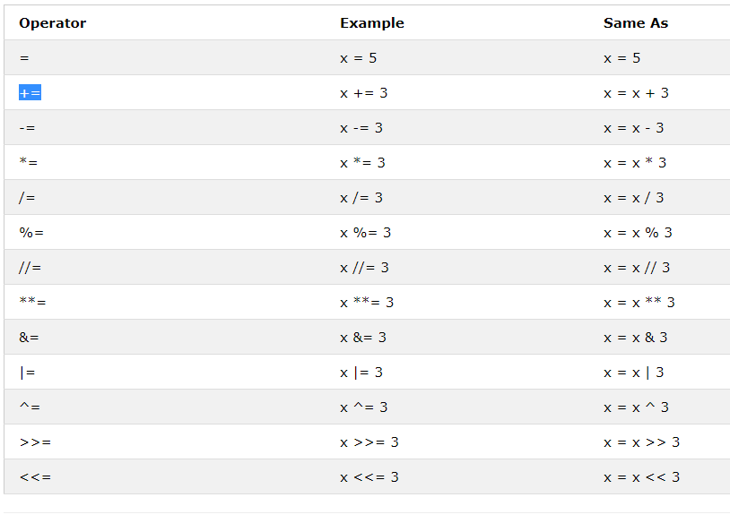
Assignment

Slide 17
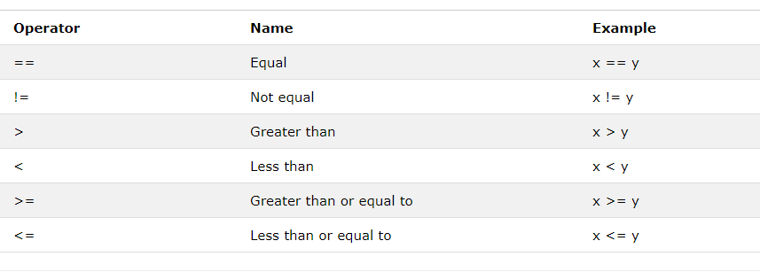
Comparision

Slide 18
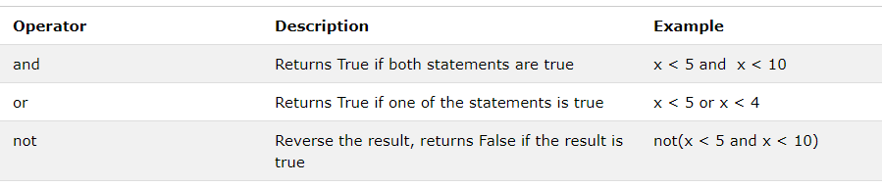
Logical

Slide 19
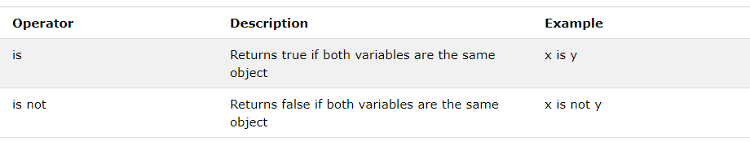
identity

Slide 20
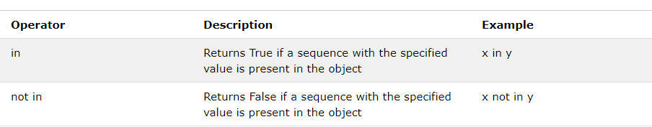
Membership

Slide 21
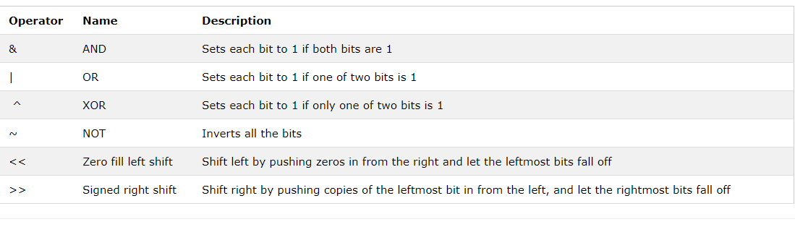
Bitwise Operators

Slide 22
XOR – exclusive OR
print(bin(0b1111 ^ 0b1111))
>>> np.bitwise_xor(13, 17)
28
>>> np.binary_repr(28)
'11100'

Slide 23
Editors
Anaconda3-5.2.0-Windows-x86_64
PyCharm
IDLE - Python

